Slide 1
Wallpaper suggestion system based on user profile, album preferences, gender, age & emotional status using advanced machine learning techniques.
Presented by,​
Salman F. Rahman (20301273)​
Md. Monjur E Elahe (23141076)

Slide 2
Aim
Introduction
Motivation/purpose/hypothesis
Dataset Analysis
Methodology
Conclusion

Slide 3
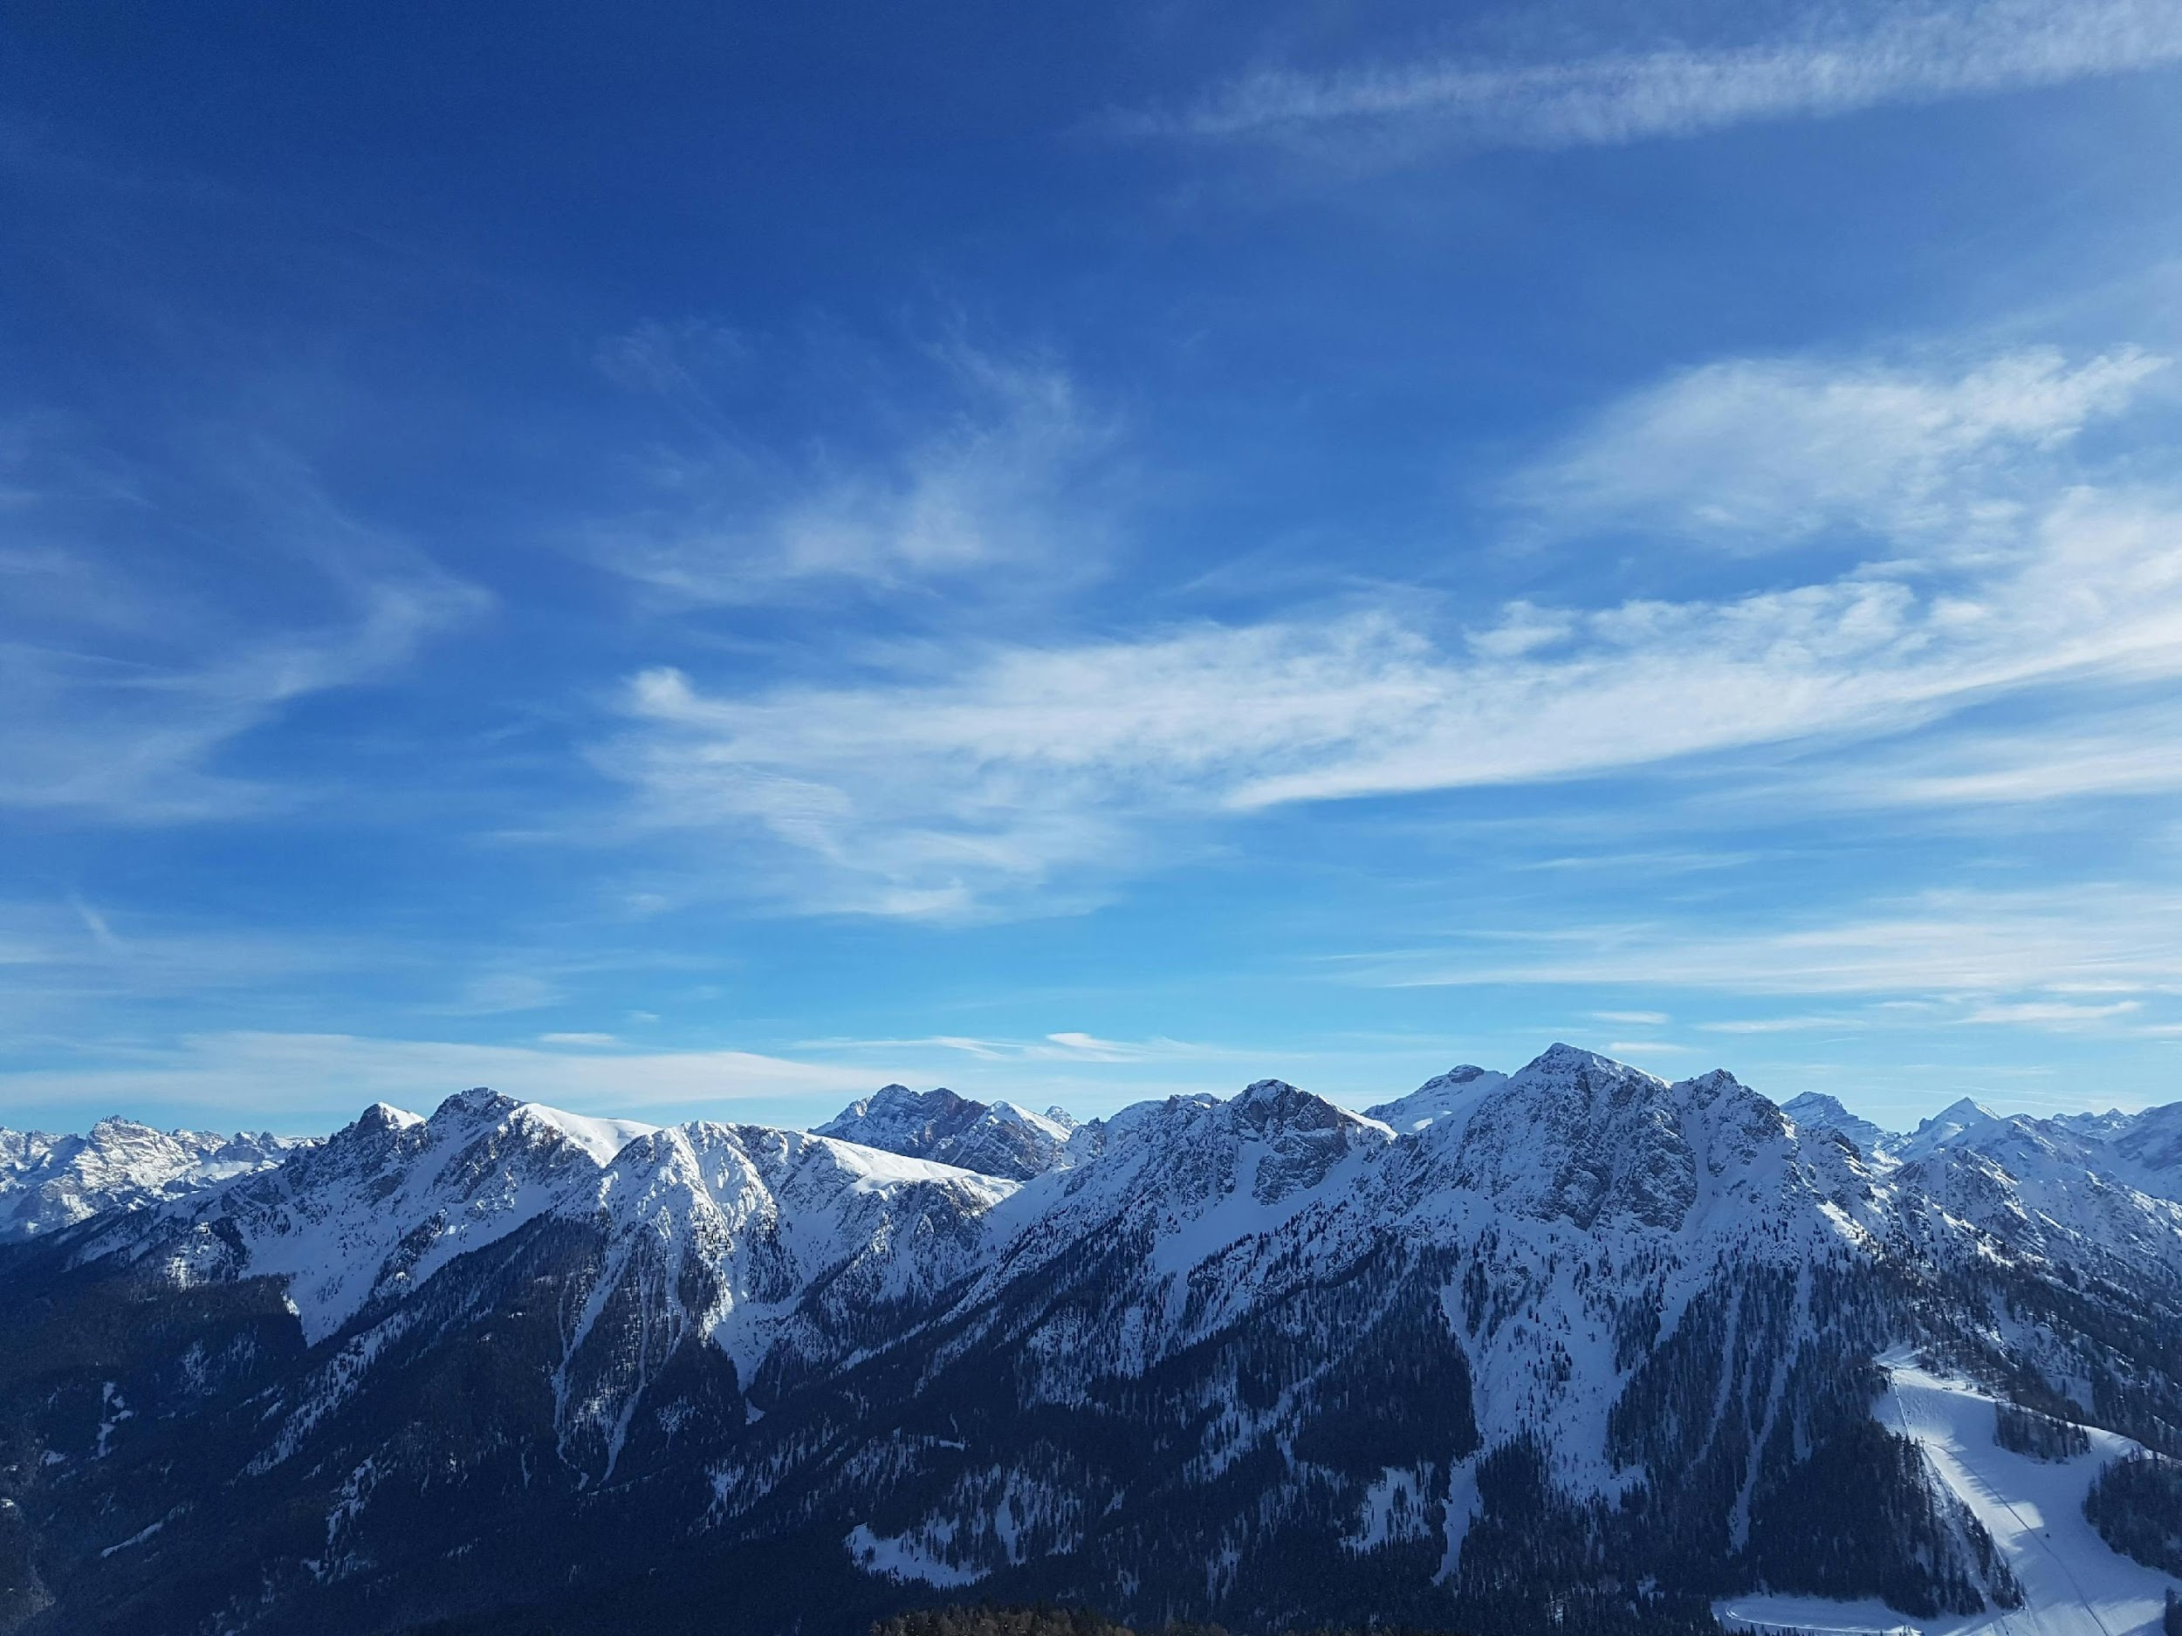
Introduction
To suggest wallpapers tailored to user profiles, preferences, and emotional status.
Approach: Leveraging advanced machine learning for personalized recommendations.

Slide 4
We will use CNN for face recognition and NLP for sentiment analysis of any walpaper lebel

Slide 5
Exploratory Data Analysis (EDA)]
Before Data Wrangling:
Overview of raw data sources.
Analysis of user profiles, album preferences, gender, age, and emotional states.
After data wrangling
Insights gained from cleaned and preprocessed data.

Slide 6
Methodology
1. Data Collection: Gathering user profile data, album preferences, etc.
2. Data Preprocessing: Cleaning, transforming, and encoding data.
3. Feature Engineering: Extracting relevant features for recommendation.
4. Machine Learning Models: Training models for personalized recommendation.
5. Recommendation Engine: Deploying the recommendation system.

Slide 7
Partially Working Prototype
Demonstration: Display screenshots or UI mockups of the prototype.
Functionality: Overview of features implemented in the prototype.
Feedback: Initial user feedback and improvements.

Slide 8
Future Steps
1. Model Refinement: Enhancing recommendation accuracy.
2. User Interface Enhancement: Improving user experience.
3. Scaling: Handling larger datasets and user bases.
4. Integration: Incorporating real-time user feedback for dynamic recommendations.

Slide 9
Dataset Analysis
Intel Image Classification
Context
This is image data of Natural Scenes around the world.
Content
This Data contains around 25k images of size 150x150 distributed under 6 categories. {'buildings' -> 0, 'forest' -> 1, 'glacier' -> 2, 'mountain' -> 3, 'sea' -> 4, 'street' -> 5 }
The Train, Test and Prediction data is separated in each zip files. There are around 14k images in Train, 3k in Test and 7k in Prediction. This data was initially published on https://datahack.analyticsvidhya.com by Intel

Slide 10
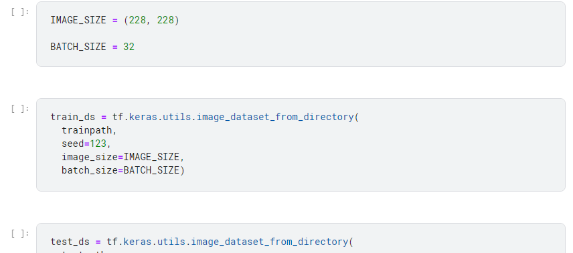
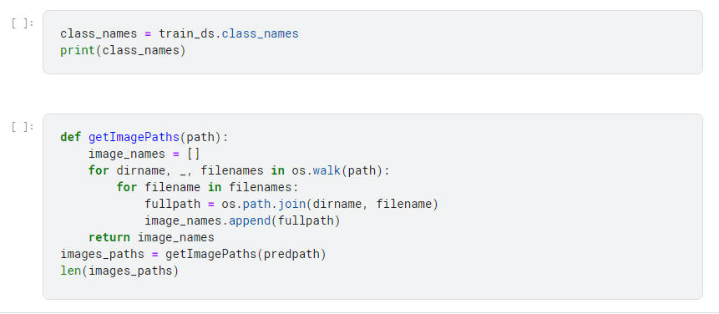
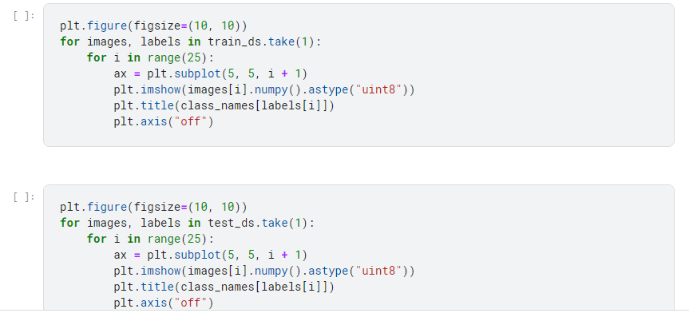
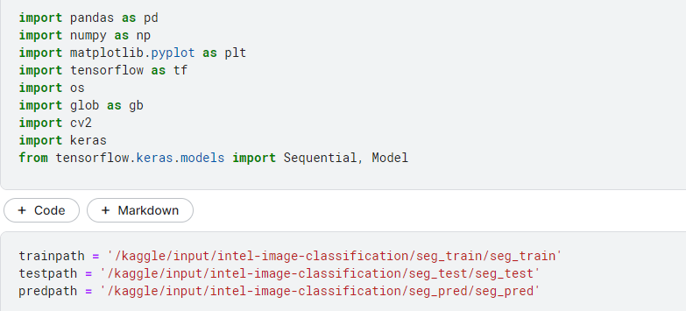

Slide 11
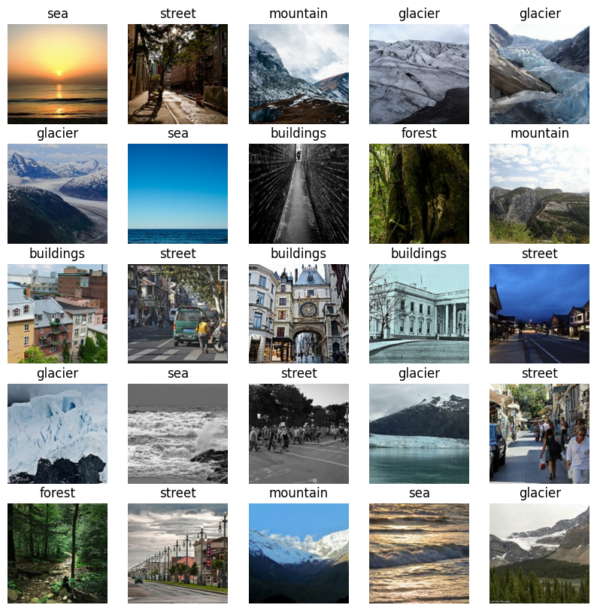

Slide 12
Conclusion
Summary: Developed a personalized wallpaper recommendation system.
Impact: Enhancing user satisfaction and engagement.
Next Steps: Continuous improvement and refinement for optimal performance.

Slide 13
Thank you

